Slide 1
Social Anxiety classifier
15.10.18

Slide 2
The task
Original data – 74 subjects
Clinical – 34
High – 20
Low - 20
Changes – removed 4 (2 high 2 low)
Added 12 low.
Goal – classify between the high and clinical from the low.

Slide 3
Describe data
Number of Features – 154
Number of subjects - 82
High - 30
Low - 52

Slide 4
Features

Slide 5
Two features groups
Aggregation features
Regression Function features

Slide 6
Aggregation features sub groups
Almost every feature group splits to 7 features -
Normalized
Disgusted
Neutral
White Space
Disgusted
All
Original
Neutral
White Space

Slide 7
Total aggregation features
Pupil size – average and STD
Fixation length – sum, average and STD
Amount of fixations - count
Fixation ratio - with/without white space
Transitions - Different AOI trans, all neutral and disgusted permutation
Others -
First and second fixations
Different AOI per trial.
Variance threat percentage
probability of first disgusted AOI fixation
Difference between medians

Slide 8
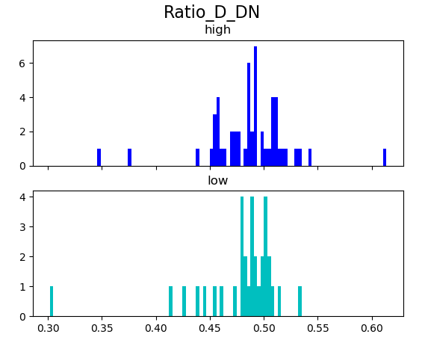
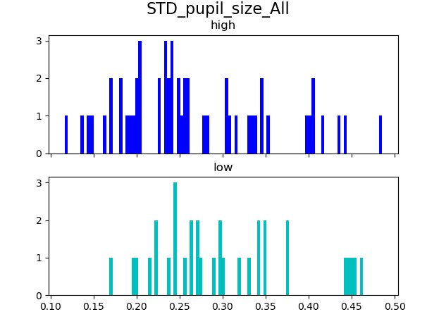
Examples

Slide 9
Regression function features sub-groups
Every regression feature have these sub groups:
Sinus parameters – STD, phase and mean
Linear regression – interception & first coefficient
Sub groups of all of the AOI’s, disgusted AOI, neutral AOI and white space AOI.

Slide 10
Regression function features
Average fixation length – norm & regular
STD fixation length
Amount of fixations – norm & regular
Sum fixation length – norm & regular
Mean different AOI per trial
Ratios - with/out white space

Slide 11
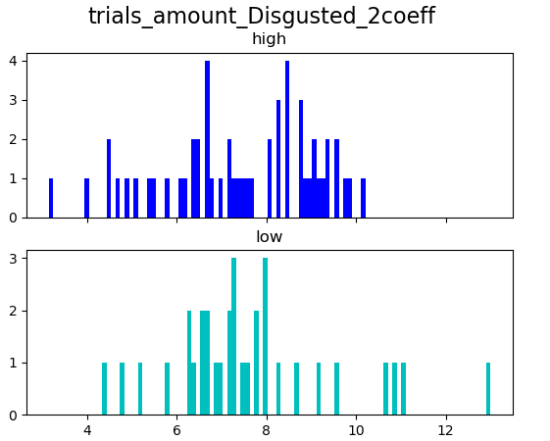
Example
Amount of disgusted fixation over trials – x coefficient

Slide 12
Missing data
130 non missing data
Mostly In the sinus regression
We decided to remove features with missing data

Slide 13
Outliers
Outlier is sample with value further than 3 STD from the mean
The max sample with outlier is subject 349, with 22 out of 130 outliers.
Didn’t exclude him

Slide 14
Feature selection

Slide 15
Pipeline
1. remove missing values
2. scaling - minmax
3. variance threshold
4. correlation threshold
5. random forest
6. PCA

Slide 16

Scaling
MinMax scaler - MinMaxScaler rescales the dataset such that all feature values are in the range [0, 1].

Slide 17
Variance threshold
After minmax standardization
Threshold – 0.05
Features with lower than threshold removed
None removed

Slide 18
Correlation threshold
Pearson correlation.
Threshold – 0.7
More then 0.7 corr features removed
Left – 42 features (many features are correlated)

Slide 19
Feature importance – extra tree classifier
This method combine the benefits of the other two methods by leveraging Machine Learning models themselves to rank and score
feature variables based on their importance
An “extra trees” classifier, “Extremely randomized trees” classifier.
Is a more random variant of a random forest.

Slide 20
Our feature importance
Results – it removes how many features we ask for.
the feature importances (the higher, the more important the feature)
0.004654558404558435 trials_ratio_N_DN2_est_std
0.023504426444489808 trials_ratio_N_DN2_est_phase
0.014089151589151588 trials_ratio_N_DN2_est_mean
…
0.02122007280159454 sum_fixation_length_All
0.046531480187709105 amount_of_first_fixations_on_threat
0.02476171039100824 amount_of_first_fixations_on_neutral
0.04616910072707583 normalized_mean_pupil_size_Neutral
0.020067312767179532 normalized_mean_pupil_size_WS
0.03644010118672833 STD_pupil_size_Disgusted

Slide 21
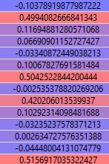
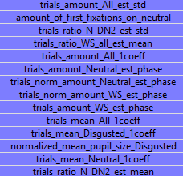
Principal Components Analysis
Our PCA

Slide 22
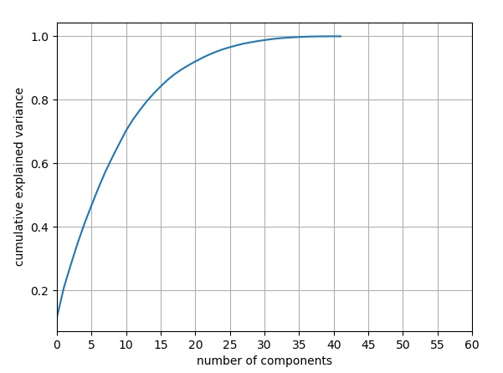
Mutual information

Slide 23
Algorithm evaluation

Slide 24
Nice pipeline
Take range of 12 to the RFA
Take range of 9 to the PCA
Min Num of features is 2
Max Num of features is 11.
Check all the algorithms and hyper parameters
Get cross validation score

Slide 25
List of the algorithms
Logistic Regression
K Nearest Neighbors
Linear Support vector machine
Random Forest
Gradient Boosting

Slide 26
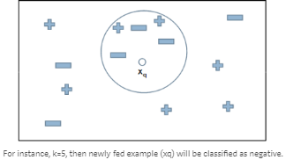
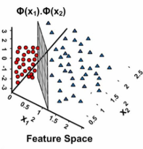
SVM
Logistic regression
K nearest neighbors
Support Vector Machines are based on the idea of finding a hyperplane that best divides a dataset into two classes.
The regression analysis for binary variables. Uses the sigmoid function.

Slide 27
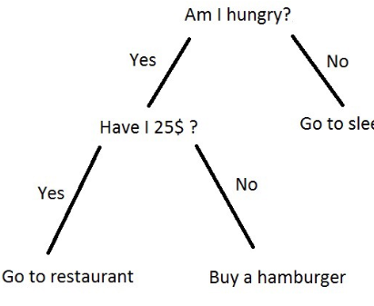
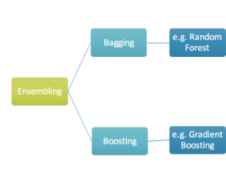
Random Forest, Gradient Boosting
Boosting - ensemble technique in which the predictors are made sequentially.
Random forest – randomness over features and samples
Bagging is ensemble technique in which we build many independent models and combine.

Slide 28
List of hyper parameter per algorithm
Logistic Regression - C
Linear Support Vector Machine - C K Nearest Neighbors Classifier – metric, N neighbors
Random Forest Classifier – N estimetors, max features, max depth, critertion.
Gradient Boosting Classifier –
Learning rate, min samples split, min samples leaf, subsample.

Slide 29
naïve algorithm
naive classifier score 0.5769230769230769

Slide 30
Results
PCA - 7 RF - 19
best classifier Pipeline(memory=None,
steps=[('classifier', RandomForestClassifier(bootstrap=True, class_weight=None, criterion='gini',
max_depth=4, max_features='auto', max_leaf_nodes=None,
min_impurity_decrease=0.0, min_impurity_split=None,
min_samples_leaf=1, min_samples_split=2,
min_weight_fraction_leaf=0.0, n_estimators=500, n_jobs=1,
oob_score=False, random_state=None, verbose=0,
warm_start=False))])
PCA - 10 RF - 19
best classifier Pipeline(memory=None,
steps=[('classifier', GradientBoostingClassifier(criterion='friedman_mse', init=None,
learning_rate=0.01, loss='deviance', max_depth=3,
max_features=None, max_leaf_nodes=None,
min_impurity_decrease=0.0, min_impurity_split=None,
min_samples_leaf... presort='auto', random_state=None, subsample=1.0, verbose=0,
warm_start=False))])
best score 0.6829268292682927

